Slide 1
Time-Lapse in Industry: 5 Years in 40 minutes
Oleksandr Kazymyrov

Slide 2
whoami
I received a Ph.D. degree in Information Security, and I am co-author of Ukrainian national standards for block cipher and hash function (DSTU 7624:2014 and DSTU 7564:2014). I am an expert in network security with several certifications such as CISSP, E|CEH (Certified Ethical Hacker) and E|CES (Certified Encryption Specialist). In addition, as a technical test manager / test analyst at EVRY, I have gained expertise in various areas of information security (i.e., security and risk management, network security, penetration testing, and operation of critical and security systems). My current position is Information Security Manager with the overall responsibility of information security in G2 Ocean, Grieg Star and Gearbulk.

Slide 3


Slide 4

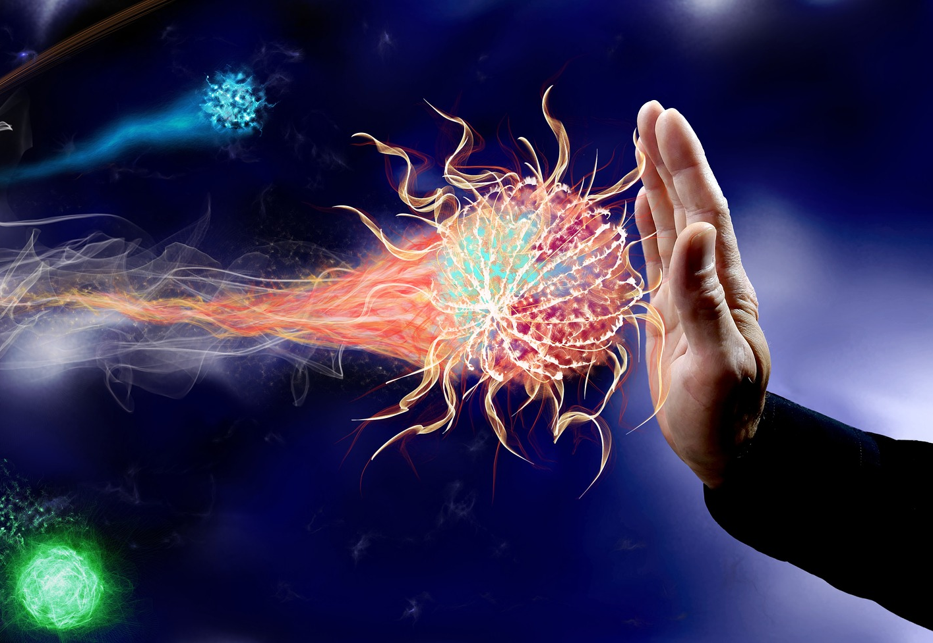
Defense
1 Jan
UiB
31 Jan
Defence Ukraine
Defence Norway
22 Apr
1 Dec
2014
Jan
Mar
May
Jul
Sep
Nov
2015
2015

Slide 5
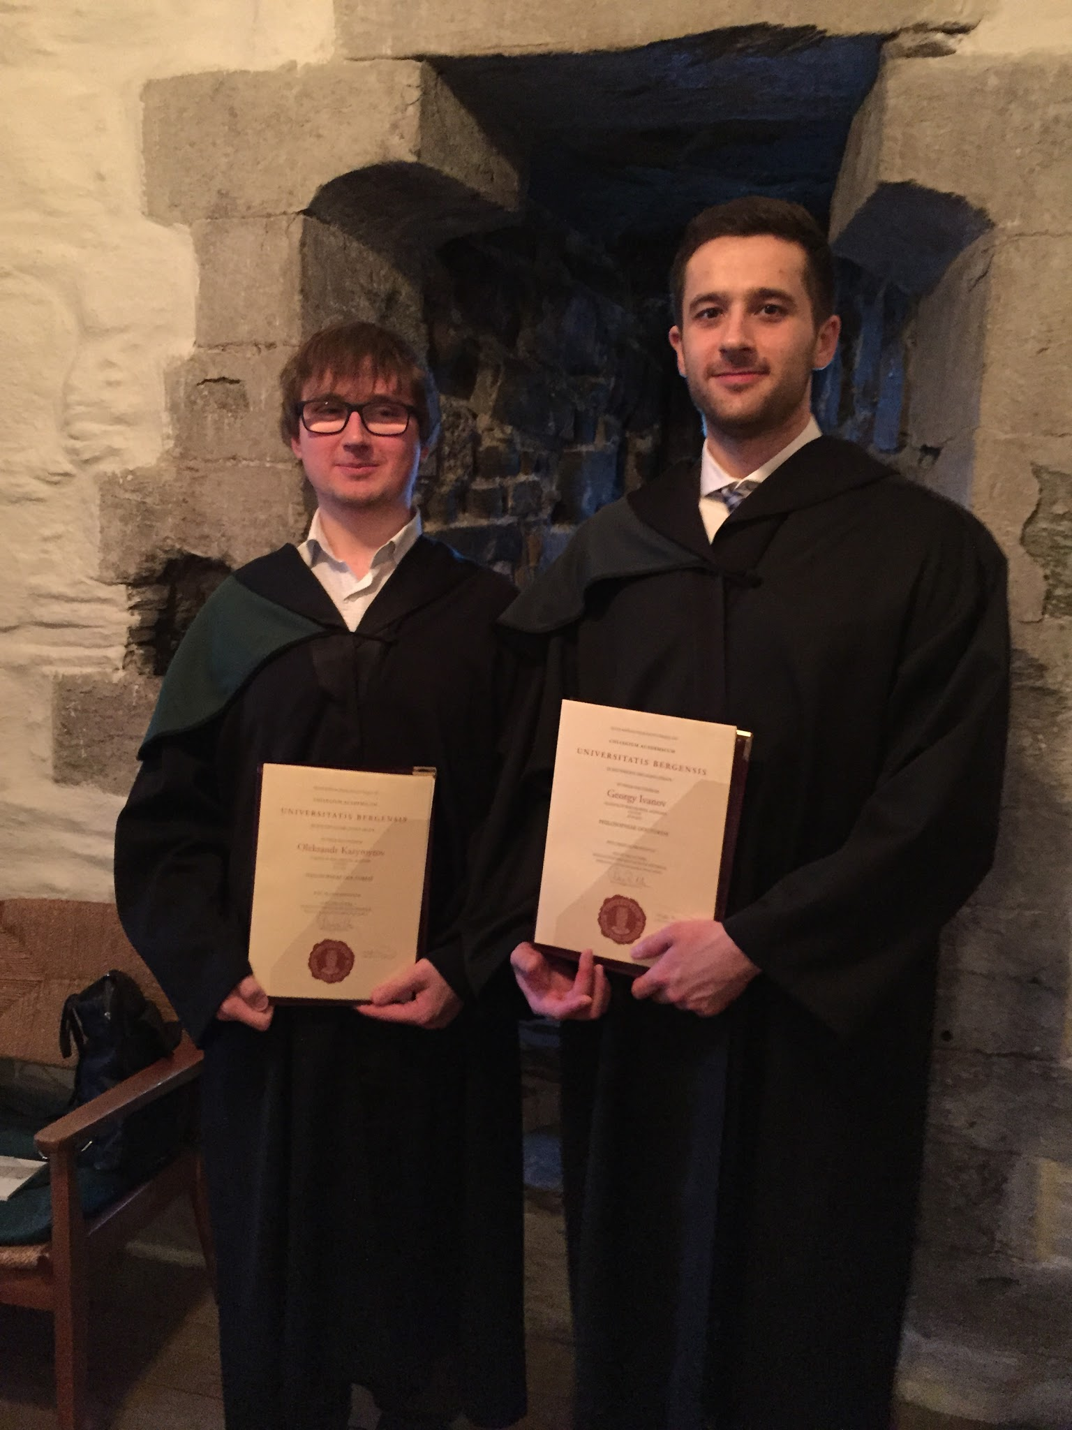
Graduation

Slide 6
Live in EVRY
8 Apr
EVRY
31 Oct
8 Apr
SECURITY ANALYSIS OF WEB APPLICATIONS/SERVICES
31 Oct
2015
2015
2016
2017
2018
2018

Slide 11
Live in EVRY
8 Apr
EVRY
31 Oct
8 Apr
SECURITY ANALYSIS OF WEB APPLICATIONS
31 Oct
8 Apr
INTERNAL
31 Oct
26 Aug
EXTERNAL
31 Oct
1 Feb
VULNERABILITY MANAGEMENT
31 Oct
6 Feb
CARD DATA SCANNING
31 Oct
2015
2015
2016
2017
2018
2018

Slide 12
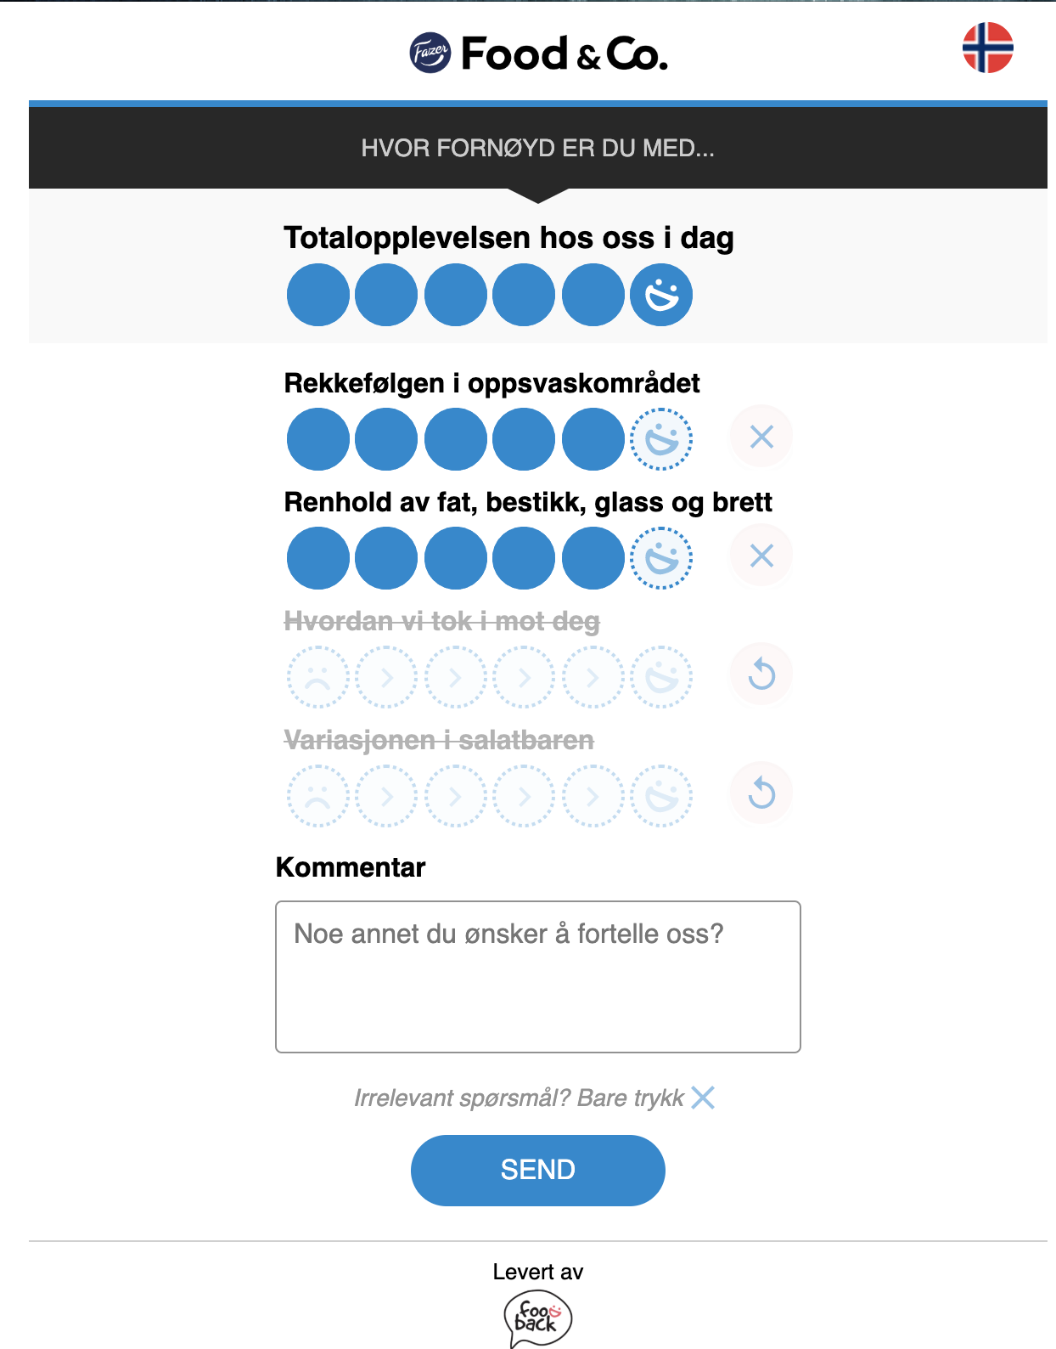
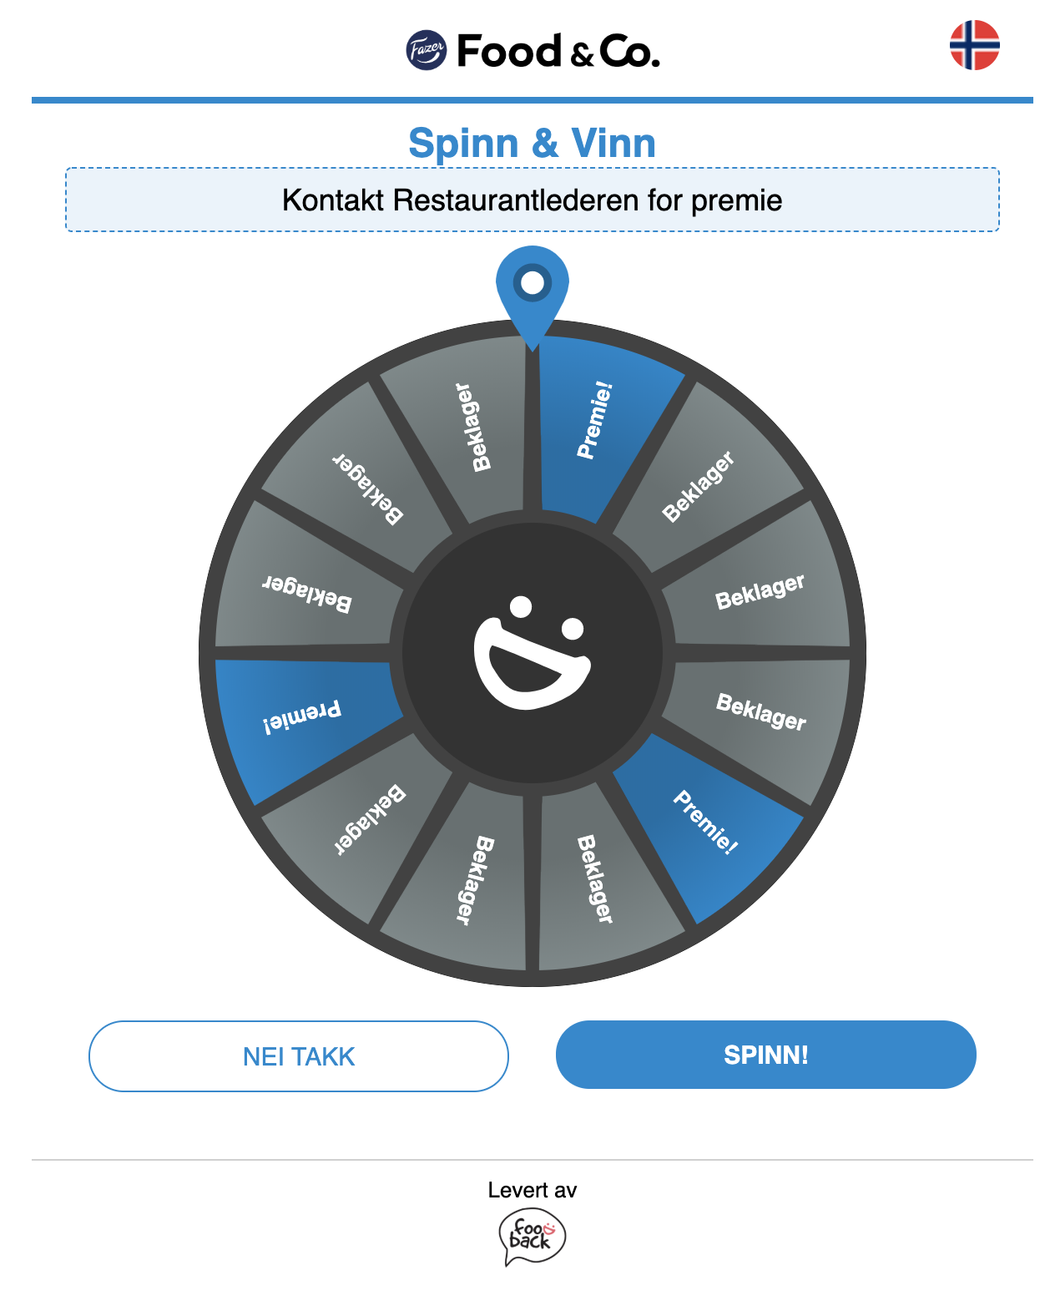

Slide 13


Slide 14
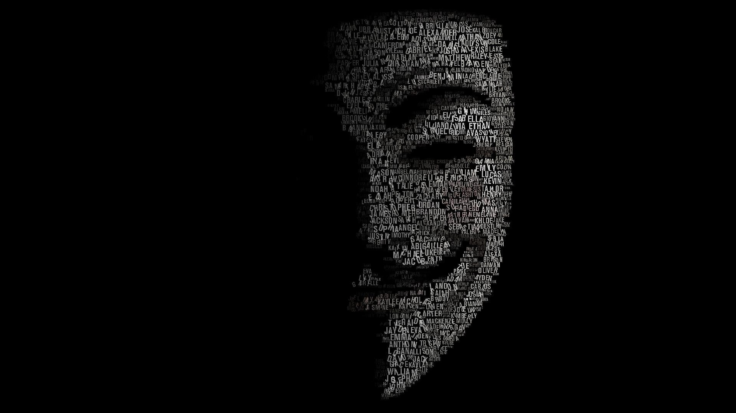

Slide 15
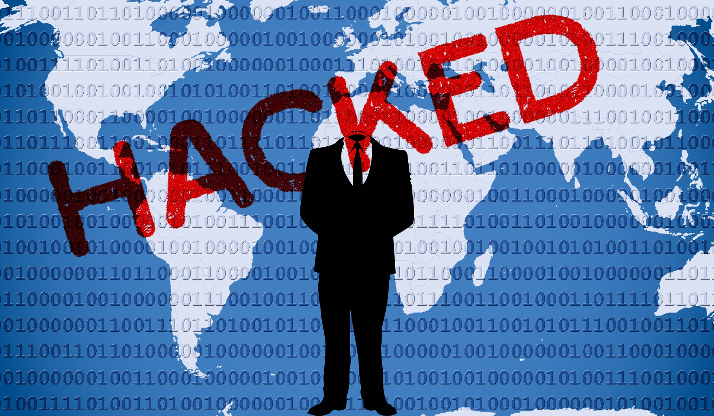

Slide 16
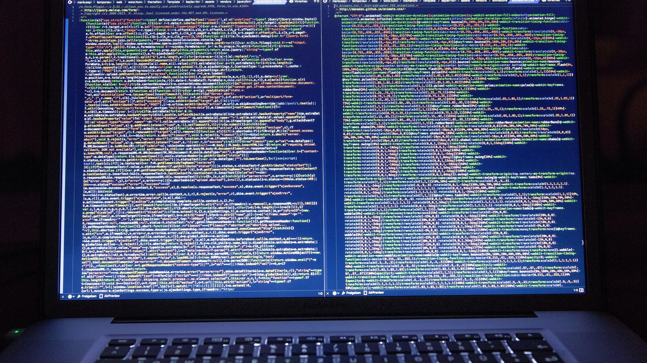

Slide 17


Slide 18


Slide 19
Live in EVRY
8 Apr
EVRY
31 Oct
8 Apr
SECURITY ANALYSIS OF WEB APPLICATIONS
31 Oct
8 Apr
INTERNAL
31 Oct
26 Aug
EXTERNAL
31 Oct
1 Feb
VULNERABILITY MANAGEMENT
31 Oct
6 Feb
CARD DATA SCANNING
31 Oct
CE2 Pentesting
C0 Pentesting
C0 Pentesting
CI Pentesting
CE2 Pentesting
CE2 Pentesting
CE2 Pentesting
CE4 Pentesting
CE4 Pentesting
CE4 Pentesting
CE4 Pentesting
Pentesting STB
Pentesting STB
5 Nov
18 Sep
2015
2015
2016
2017
2018
2018

Slide 20
Certifications

Slide 21
Live in EVRY
8 Apr
EVRY
31 Oct
8 Apr
SECURITY ANALYSIS OF WEB APPLICATIONS
31 Oct
8 Apr
INTERNAL
31 Oct
26 Aug
EXTERNAL
31 Oct
1 Feb
VULNERABILITY MANAGEMENT
31 Oct
6 Feb
CARD DATA SCANNING
31 Oct
CE2 Pentesting
C0 Pentesting
C0 Pentesting
CI Pentesting
CE2 Pentesting
CE2 Pentesting
CE2 Pentesting
CE4 Pentesting
CE4 Pentesting
CE4 Pentesting
CE4 Pentesting
Pentesting STB
Pentesting STB
5 Nov
18 Sep
2015
2015
2016
2017
2018
2018
19 Apr
15 Nov
16 Nov
Certified Ethical Hacker
Certified Encryption Specialist
CISSP

Slide 22
Talks
EHiN 2018
Kan krypto gjøre at hvor data lagres blir uvesentlig?
NDC Oslo 2018
Getting benefits of OWASP ASVS at initial phases
PHDays 7
Jumping from Tenable's SecurityCenter CV to production environments
TestWarez 2016
OWASP ASVS for NFTaaS in Financial Services

Slide 23
Live in EVRY
8 Apr
EVRY
31 Oct
8 Apr
SECURITY ANALYSIS OF WEB APPLICATIONS/SERVICES
31 Oct
8 Apr
INTERNAL
31 Oct
26 Aug
EXTERNAL
31 Oct
1 Feb
VULNERABILITY MANAGEMENT
31 Oct
6 Feb
CARD DATA SCANNING
31 Oct
CE2 Pentesting
C0 Pentesting
C0 Pentesting
CI Pentesting
CE2 Pentesting
CE2 Pentesting
CE2 Pentesting
CE4 Pentesting
CE4 Pentesting
CE4 Pentesting
CE4 Pentesting
Pentesting STB
Pentesting STB
7 Nov
18 Sep
2015
2015
2016
2017
2018
2018
19 Apr
25 May
16 Nov
28 May
13 Nov
Certified Encryption Specialist
15 Nov
PHDays 7
CISSP
PHDays 7
EHiN 2018
Certified Ethical Hacker
26 Sep
TestWarez 2016

Slide 24



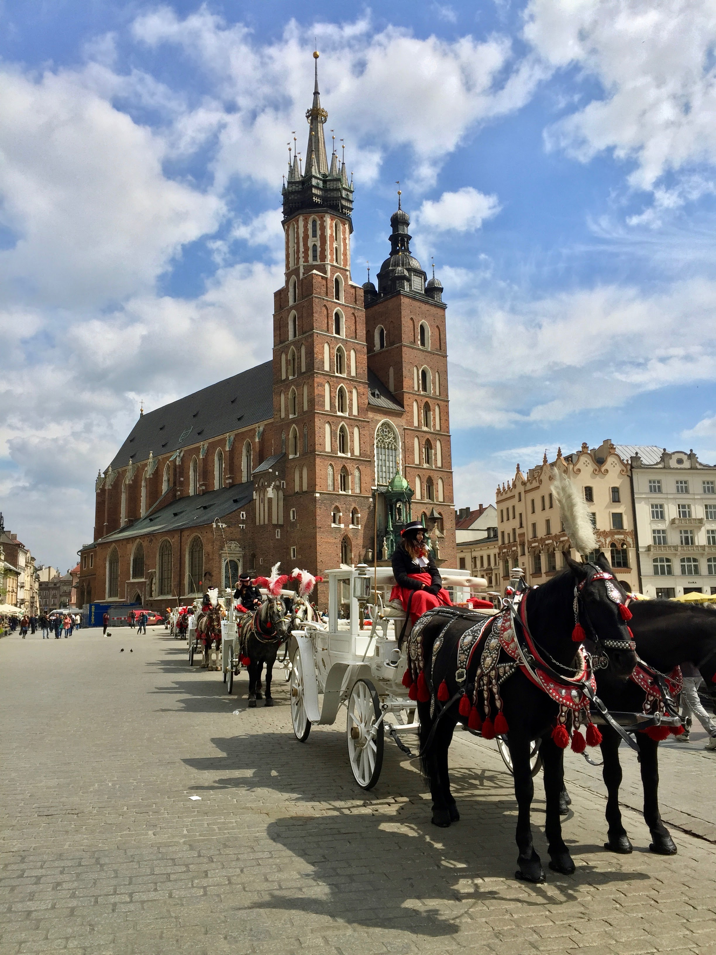

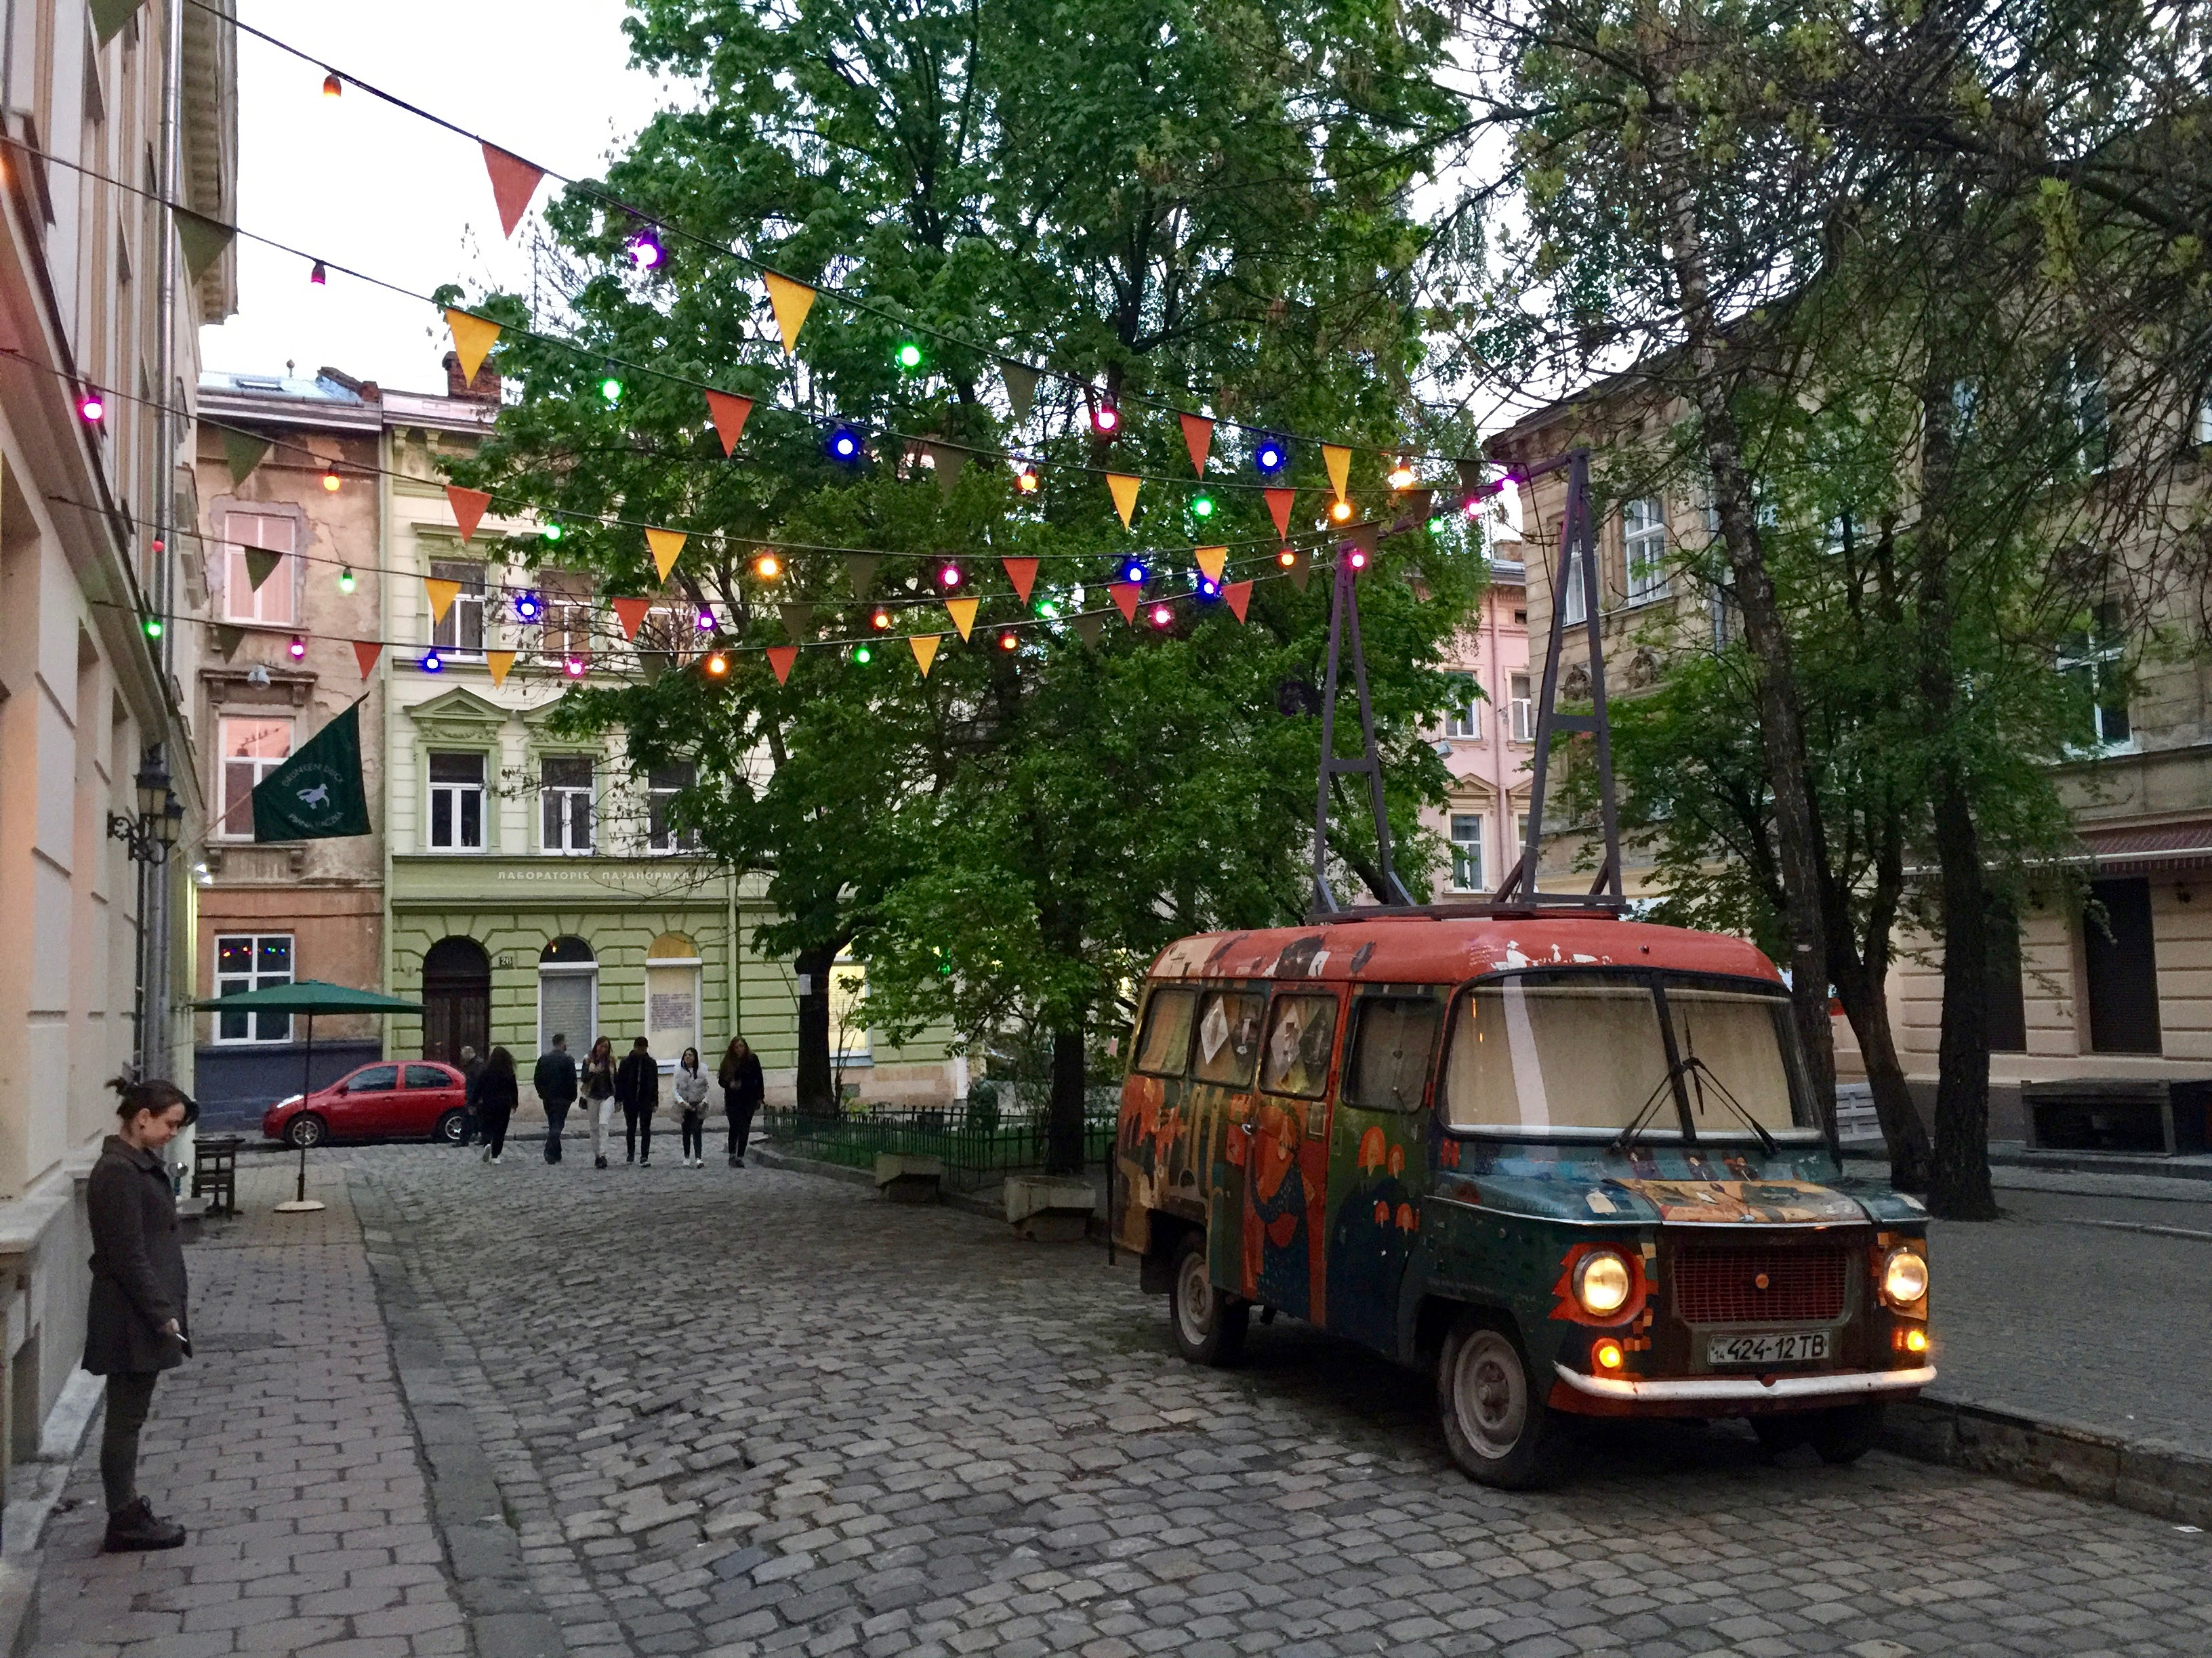

Slide 25
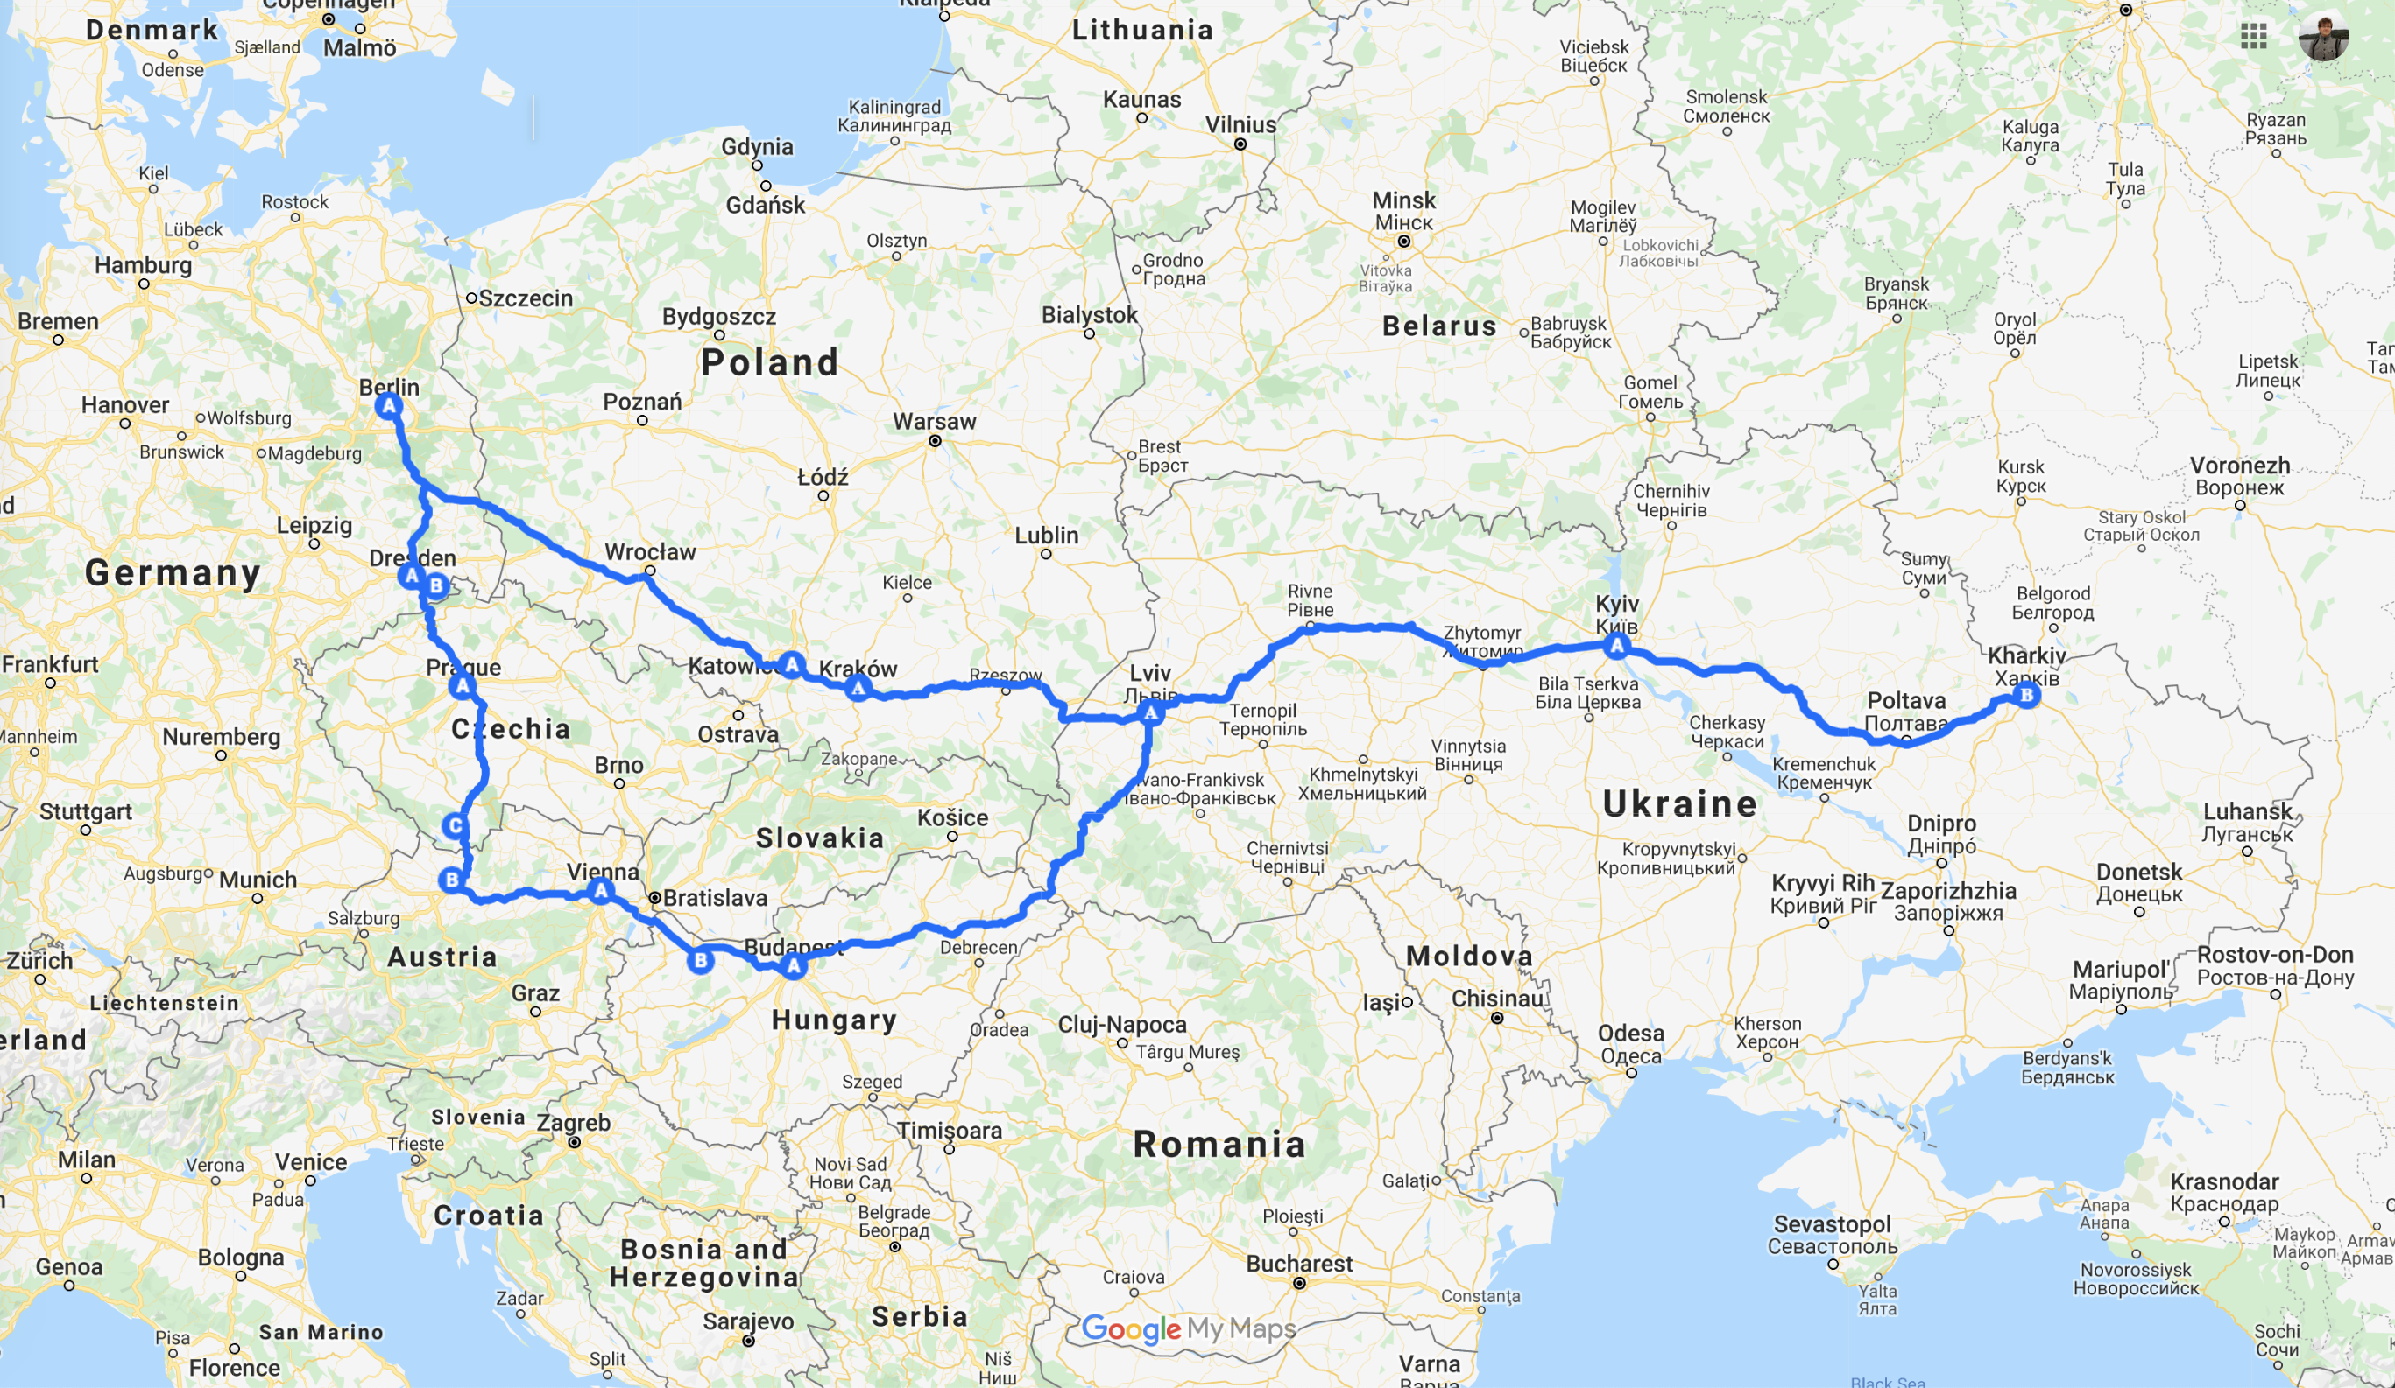

Slide 26
Live in EVRY
8 Apr
EVRY
31 Oct
8 Apr
SECURITY ANALYSIS OF WEB APPLICATIONS/SERVICES
31 Oct
8 Apr
INTERNAL
31 Oct
26 Aug
EXTERNAL
31 Oct
1 Feb
VULNERABILITY MANAGEMENT
31 Oct
6 Feb
CARD DATA SCANNING
31 Oct
CE2 Pentesting
C0 Pentesting
C0 Pentesting
CI Pentesting
CE2 Pentesting
CE2 Pentesting
CE2 Pentesting
CE4 Pentesting
CE4 Pentesting
CE4 Pentesting
CE4 Pentesting
Norway
Czech Republic
Euro Trip
Pentesting STB
Hungary
Pentesting STB
19 Oct
6 Sep
17 Apr
7 Nov
1 Jul
18 Sep
2015
2015
2016
2017
2018
2018
19 Apr
25 May
16 Nov
28 May
13 Nov
Certified Encryption Specialist
15 Nov
PHDays 7
CISSP
PHDays 7
EHiN 2018
Certified Ethical Hacker
26 Sep
TestWarez 2016

Slide 27
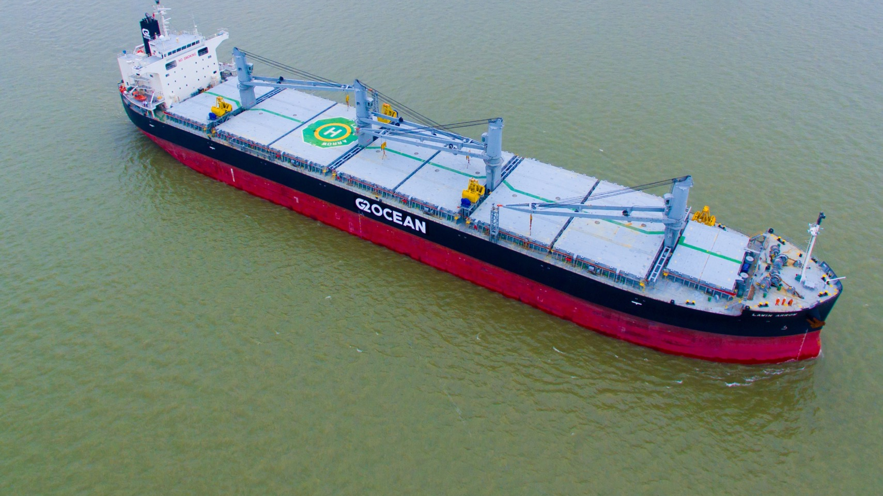
G2 Ocean
PIONEERING SUSTAINABLE SHIPPING SOLUTIONS

Slide 29
UnITy

Slide 30
What is UnITy?
Grieg Star
G2 Ocean
Gearbulk
Land
Sea
Land
Land
Sea
InfoSec
UnITy

Slide 31
Metamorphosis

Slide 32
The Cyber Kill Chain

Slide 33
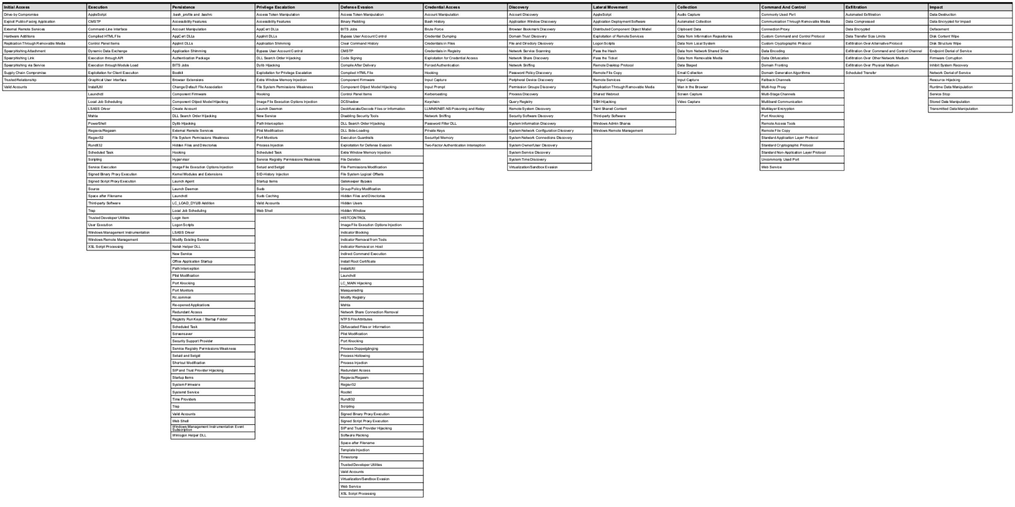
MITRE ATT&CK
Enterprise Techniques: 244
Mobile Techniques: 67
PRE-ATT&CK Techniques: 174
https://mitre-attack.github.io/attack-navigator/enterprise/#

Slide 34
NIST Cybersecurity Framework

Slide 36
Live in G2 Ocean
1 Nov
G2 Ocean
25 Nov
SecOps
31 Dec
25 Nov
Asset Management
31 Dec
25 Nov
Establish SIEM
3 Feb
2 Aug
Establish BCDR
18 Mar
25 Nov
Establish EDR
7 Apr
25 Nov
Establish Vulnerability Management
1 Jul
25 Nov
Cybersecurity Month 2019
1 Oct
31 Oct
UnITy
SIEM is established
G2 Ocean is free from malware
1 Jan
2 Aug
20 Sep
2018
Nov
2019
Mar
May
Jul
Sep
Nov
Today

Slide 38
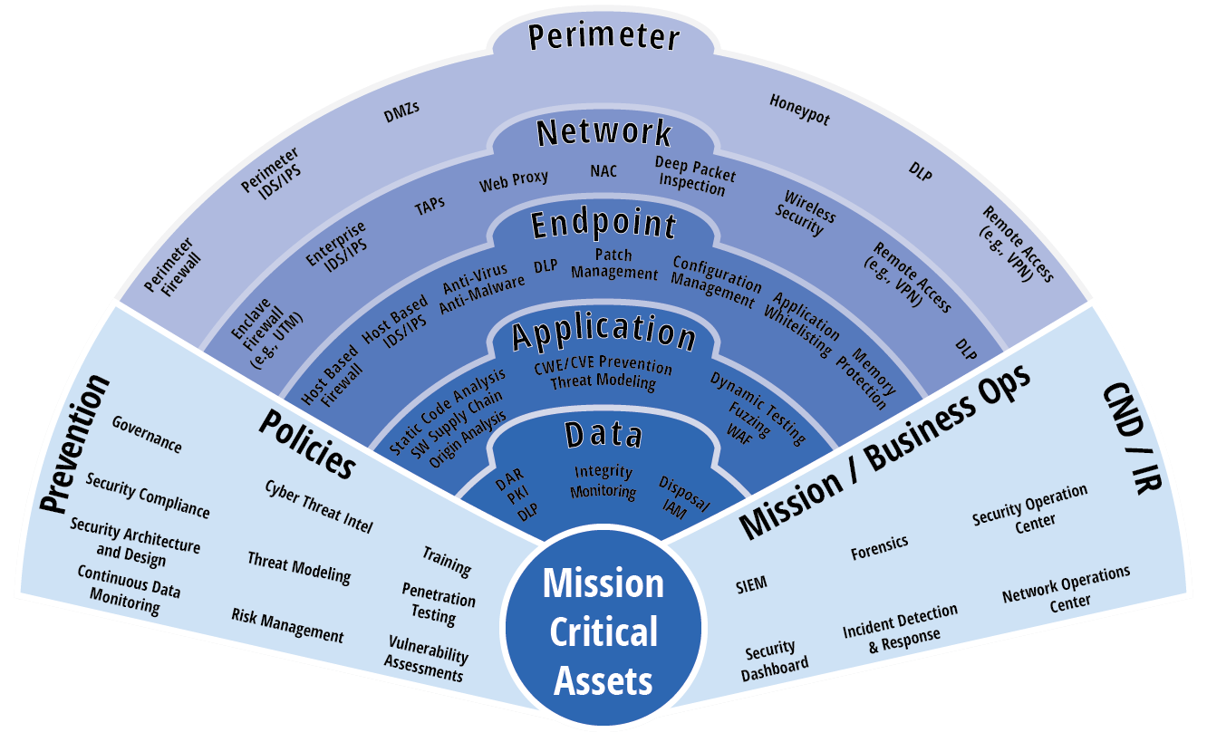
Layered Security (Defence in Depth)
Source: https://www.tmctechnologies.com/cyber/

Slide 39
5 Years in 40 Minutes
EVRY
8 Apr
31 Oct
Security Analysis of Web Applications
8 Apr
31 Oct
Vulnerability Management
1 Feb
31 Oct
Card Data Scanning
6 Feb
31 Oct
Network Pentesting
UiB
G2 Ocean
SecOps
Asset Management
Establish SIEM
Establish BCDR
Establish EDR
Establish Vulnerability Management
Cybersecurity Month 2019
Defence Ukraine
Defence Norway
Norway
Czech Republic
Euro Trip
Hungary
UnITy
19 Oct
6 Sep
17 Apr
1 Jul
1 Jan
SIEM is established
22 Apr
1 Dec
2 Aug
2014
2014
2015
2016
2017
2018
2019
2019
25 May
16 Nov
28 May
13 Nov
20 Sep
15 Nov
PHDays 7
CISSP
PHDays 7
EHiN 2018
G2 Ocean is free from malware
19 Apr
Certified Ethical Hacker
Certified Encryption Specialist

Slide 40
